Slide 1
Providing an Analytical and Operational Advantage
Preparedness without Paranoia™
®
™

Slide 2
KGH Mission Space
Kiernan Group Holdings is an intelligence, law-enforcement and national security consulting, training, and problem-solving firm providing tailored solutions to complex challenges. We operate with, and for an operational and analytic advantage in a world where experience matters.

Slide 3
Who We Are
• Woman-owned Small Business (WOSB) • Founded in 2009
• GSA 84 | Total Solutions for Security
Partners
Affiliations

Slide 4
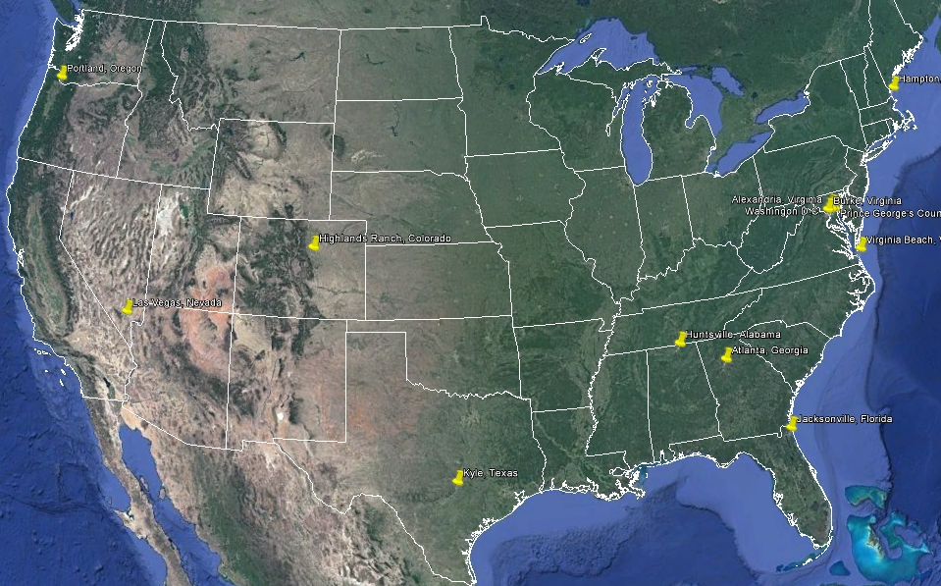
Where We Are

Slide 5
What We Do & How We Do It!
KGH’s subject matter experts integrate a spectrum of multi-disciplinary expertise to deliver on-target messages with profound impact.
The Pedagogy Of It All: KGH develops digital storytelling to convey powerful, meaningful and measurable learning. We align message to audience with advanced multi-media delivery, fueled by dynamic technology platforms. We understand that learning occurs best when driven by the learner.
We create compelling training and outreach programs that leverage both the rigor and the creativity of instructional design models. We exercise that learning through tabletop exercises, reinforcement and reengagement.
We capture the power of technology through discovery, exploitation, integration and often, recombination of ideas and capabilities for more optimum utilization. We partner with trusted and emerging technology experts. We promote the integration and transition of responsive solutions into the workplace, from office environments to the battlefield.
The Phenomenology Of It All: We merge the earned experience from disparate and divergent walks of life to develop and enhance thought leadership. We challenge and exercise decision-making processes from mundane to critical life scenarios tailored to need and environment.
Experience Matters

Slide 6
Education and Training
KGH trains, tests, equips and fields experienced core instructors enabled by rigorous analytic products and state of the practice instructional design and delivery capabilities.
KGH has earned specialized experience in active shooter, active threat, active assailant and the behavioral based trajectory involved in the pathway to violence across the critical infrastructure and faith-based community.
KGH believes that the best defense to active threat is a prepared and engaged citizenry who operate in a soft target environment with a hard target mindset. This education starts at the supper table and extends to the boardroom table.
KGH can design learning environments tailored to need that are interactive, dynamic and iterative, measuring progress and providing actionable feedback.

Slide 7
Furciferi Versuti®
Crafty Bastards Workshops offer unique fora that engage a nontraditional range of Subject Matter Experts to discover and mine breakout ideas using diverse conceptual and contextual lenses, enabling new institutional paradigms and overcoming hidden biases which hobble innovation.
CBW addresses poorly or inaccurately identified emerging threats, challenges, and scenarios.
CBW identifies and exposes disruptive threats which may not fit the value chain, innovation cycle, or patterns of traditional threats.
CBW DNA: Thinking faster than the speed of threat requires refined cognitive agility and the habitual acceptance of divergent opinions and earned experience.
®
KGH Proprietary

Slide 8
Emerging Technology Innovation Center (ETIC™)
ETIC provides a venue for evaluating, exploiting, and enhancing select technologies relevant to our clients.
ETIC focuses on innovative technology applications that address the common requirements of law enforcement, military, government, and the private sector.
ETIC develops cutting-edge applications needed to successfully launch an emerging technology leveraging practitioner-earned knowledge and tradecraft and street-craft skills.
™
KGH Proprietary

Slide 9
Preparedness Without Paranoia™
Preparedness Without Paranoia™ (PWP) is an approach that fosters an educated, engaged and resilient organization whose workforce, once trained, will be prepared, confident and capable of reacting appropriately and effectively to any active threat.
The core PWP approach equips organizations and their workforce with the knowledge to Prepare for, Respond to, and Recover from active threats, a capability which transcends where we work, where we live, where we worship, where we learn, where we shop, and where we play.
PWP provides training on situational awareness to: a) understand today’s multidimensional threat environment, b) recognize telltale signs of an evolving threat, c) empower people to take effective action, and d) understand how to recover and resume one’s daily activities in an effective manner.
Minor Visions™ extends KGH’s Preparedness Without Paranoia™ (PWP) approach with an eye towards the next generation of citizenry. KGH’s “Security is Cool” approach is PWP customized for kids-our most valuable yet most vulnerable national asset.
KGH Proprietary

